Slide 1

Chapter 23
Process-to-Process Delivery:
UDP and TCP

Slide 2
23-1 PROCESS-TO-PROCESS DELIVERY
The transport layer is responsible for process-to-process delivery—the delivery of a packet, part of a message, from one process to another. Two processes communicate in a client/server relationship, as we will see later.

Slide 3
Process-to-process Delivery
The data link layer is responsible for delivery of frames between two neighboring nodes over a link.
  This is called node-to-node delivery.
The network layer is responsible for delivery of datagram between two hosts.
  This is called host-to-host delivery.

Slide 4

Process-to-process Delivery(cont’d)
Transport layer is responsible for process-to-process delivery, the delivery of a packet, part of a message, from one process to another.
Two processes communicate in a client-server relationship

Slide 5
Process-to-process Delivery(cont’d)
Client/Server Paradigm
  The most common process-to-process communication is though the Client/Server Paradigm.
    Client : A process on the local host
    Server : A process on the remote host to provide services.
  Both processes (Client and Server) have the same name.
    Ex.) day time Client process and day time Server process.
  For communication, we must define the following;
    Local host
    Local process
    Remote host
    Remote process

Slide 6
Process-to-process Delivery(cont’d)
Addressing
  A frame in the data link layer needs a destination MAC address.
  At the network layer, we need an IP address.
  At the transport layer, we need a transport layer address, called a Port number to choose among multiple processes running on the host.
  In the Internet model
    The port No. : 0~65,535 (16-bit integer)
  Well-known port number
    Universal port No. for server (fixed value, ranging : 0 ~1,023)
  Ephemeral port number
    A port No. chosen randomly by the transport layer SW running on the client host.

Slide 7

Process-to-process Delivery(cont’d)
Addressing
  Port number

Slide 8

Process-to-process Delivery(cont’d)
Addressing
  IP addresses Versus Port numbers

Slide 9
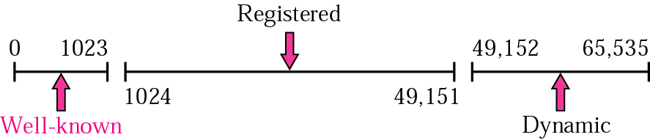
Process-to-process Delivery(cont’d)
IANA Ranges
  IANA (Internet Assigned Number Authority) had divided the port numbers into three ranges :
  Well-known ports
    Ranging : 0 ~ 1,023
    Controlled by IANA.
  Registered Port
    Ranging : 1,024 ~ 49,151
    Are not assigned or controlled by IANA.
  Dynamic Port
    Ranging : 49,152 ~ 65,535
    Are neither controlled nor registered.
    These are the ephemeral port.

Slide 10

Process-to-process Delivery(cont’d)
Socket Addresses
  The combination of an IP address and a port number.
  A transport layer protocol needs a pair of socket addresses: the client socket address and the server socket address.

Slide 11
Process-to-process Delivery(cont’d)
Multilexing and Demultiplexing
  Multiplexing
    At the sender site, there may be several processes to send packets, and there is only one transport layer protocol (UDP or TCP) at any time.
    This is a many-to-one relationship and requires multiplexing.
    After adding the header, the transport layer passes the packet to the network layer.
  Demultiplexing
    At the receiver site, the relationship is one-to-many and requires demultiplexing.
    The transport layer receives datagrams from the network layer.
      After error checking and dropping of the header, the transport layer delivers each message to the appropriate process based on the port number.

Slide 12

Process-to-process Delivery(cont’d)
Multiplexing and Demultilexing

Slide 13
Connectionless Vs Connection-Oriented Service
Connectionless Service
  The packets are not numbered; they may be delayed or connection release.
  There is no acknowledgment either.
  UDP protocol is connectionless in the Internet model.
Connection-Oriented Service
  A connection is first established between the sender and the receiver.
  Data are transferred.
  At the end, the connection is released.
  TCP and SCTP are connection-Oriented protocols.

Slide 14
Reliable Versus Unreliable
Reliable Service
  If the application layer program needs reliability, we use a reliable transport protocol such as TCP and SCTP.
  This means a slower and more complex service.
Unreliable Service
  If the application layer program does not need reliability because it uses its own flow and error control mechanism or it needs fast service or the nature of the service does not demand flow and error control (real-time application), then unreliable protocol such as UDP can be used.
Do we need reliability control at the transport layer, even the data link layer is reliable and has flow and error control ?
  The answer is yes.
  The network layer in the Internet is unreliable (best-effort delivery), we need to implement reliability at the transport layer.

Slide 15

Error control
Figure 23.7 Error control

Slide 16

Three Protocols
Position of UDP,TCP, and SCTP in TCP/IP suite

Slide 17
23-2 USER DATAGRAM PROTOCOL (UDP)
The User Datagram Protocol (UDP) is called a connectionless, unreliable transport protocol. It does not add anything to the services of IP except to provide process-to-process communication instead of host-to-host communication.
Topics discussed in this section:
Well-Known Ports for UDP
User Datagram
Checksum
UDP Operation
Use of UDP

Slide 18
UDP (cont’d)
If UDP is so powerless, why would a process want to use it ?
  very simple protocol using a minimum of overhead
    if a process wants to send a small message and does not care much about reliability, it can use UDP
    if it sends a small message, taking much less interaction between the sender and receiver than it does using TCP

Slide 19
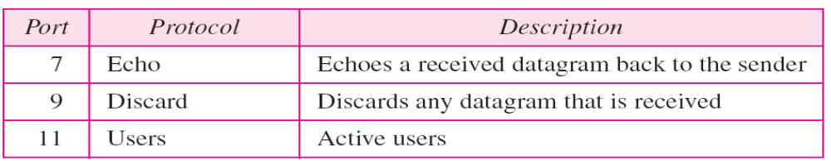
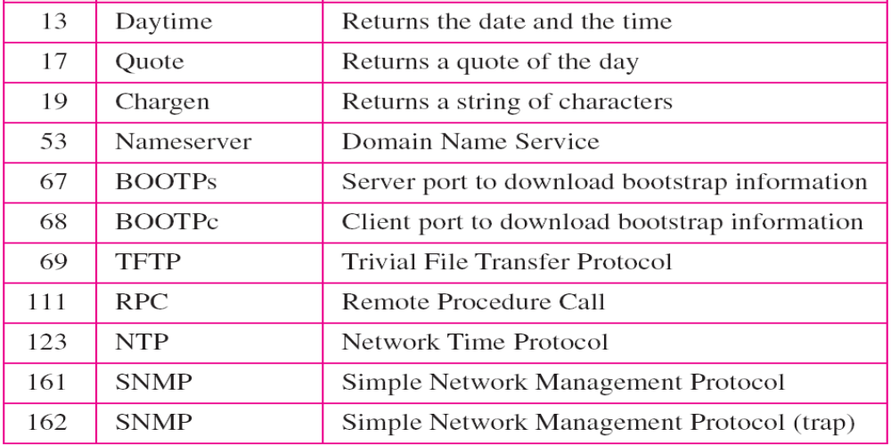
Table 23.1 Well-known ports used with UDP

Slide 20

User Datagram Protocol (UDP)
User Datagram
  Including fixed 8 byte header
The calculation of checksum and its inclusion in the user datagram are optional.
UDP length = IP length – IP header’s length

Slide 21

User Datagram Protocol (UDP)
Figure 23.10 Pseudoheader for checksum calculation

Slide 22

Figure 23.11 Checksum calculation of a simple UDP user datagram

Slide 23
UDP Operation
Connectionless Services
  UDP provides a connectionless services that each datagram sent by UDP is an independent datagram.
Flow and Error Control
  There is no flow control and hence no window mechanism.
  There is no error control mechanism in UDP except for the checksum.
Encapsulation and Decapsulation
  The UDP protocol encapsulates and decapsulates messages in an IP datagram.

Slide 24
UDP Operation (cont’d)
Queuing
  At client site
    When a process starts, it requests a port No. from the operating system.
    The client process sends messages to the outgoing queue by using the source port No. specified in the request.
    UDP removes the messages one by one and, after adding the UDP header, delivers them to IP.
    An outgoing queue can overflow. If this happens, the OS can ask the client process to wait before sending any more messages.
    When a message arrives for a client, UDP checks to see if an incoming queue has been created for the port No. specified in the destination port No. field of the user datagram. If there is a queue, UDP sends the received user datagram to the end of the queue.

Slide 25
UDP Operation (cont’d)
Queuing
  At Server site
    When it starts running, a server asks for incoming and outgoing queues, using its well-known port.
    When a message arrives for a server,
    UDP checks to see if an incoming queue has been created for the port number specified in the destination port number field of the user datagram.
    If there is a queue, UDP sends the received user datagram to the end of the queue.
    When a server wants to respond to a client, it sends messages to the outgoing queue, using the source port No. specified in the request.
    UDP removes the messages one by one and, after adding the UDP header, delivers them to IP.

Slide 26

Figure 23.12 Queues in UDP

Slide 27
Applications of UDP
UDP is suitable for a process that requires simple request-response communication with little concern for flow and error control.
  Not used for sending bulk data, such as FTP
  TFTP including internal flow and error control
  Suitable transport protocol for multicasting
  Used for some route updating protocols such as Routing Information Protocol (RIP)
  Used for management processes such as SNMP.

Slide 28
23-3 TCP
TCP is a connection-oriented protocol; it creates a virtual connection between two TCPs to send data. In addition, TCP uses flow and error control mechanisms at the transport level.
Topics discussed in this section:
TCP Services
TCP Features
Segment
A TCP Connection
Flow Control
Error Control

Slide 29
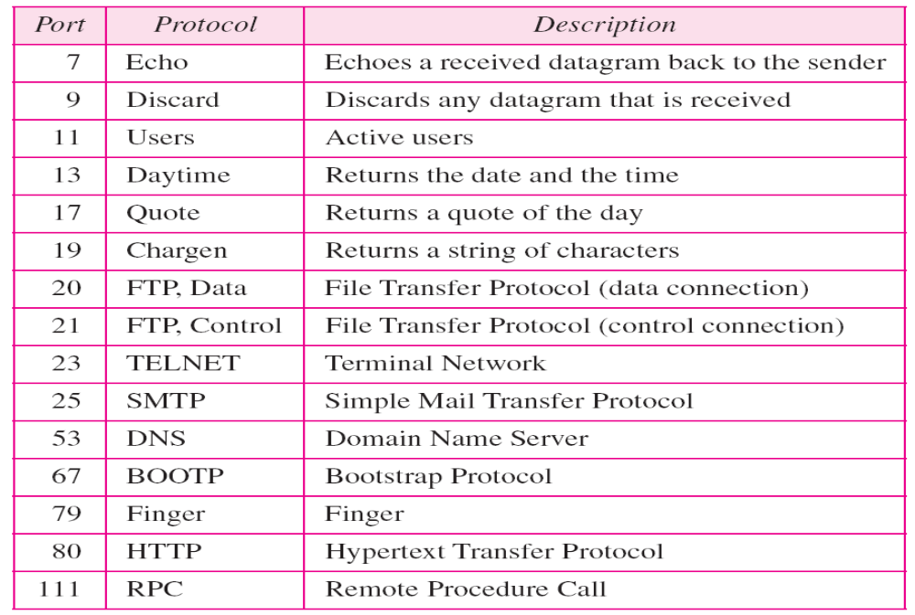
TCP Services
Process-to-process Communication
  Like UDP, TCP provides process-to-process communication using port numbers.
    well-known ports used by TCP

Slide 30

TCP Services
Stream Delivery Service
  TCP is a stream-oriented protocol
  TCP creates an environment in which the two processes seem to be connected by an imaginary “tube” that carries their data across the Internet.

Slide 31

TCP Services (cont’d)
Sending and Receiving Buffers
  Because the sending and receiving processes may not produce and consume data at the same speed, TCP needs buffers for storage.
  One way to implement is to use a circular array

Slide 32
TCP Services (cont’d)
Segments
  At the transport layer, TCP groups a number of bytes together into a packet called a segment.
  TCP adds a header to each segment (for control purposes) and delivers the segment to the IP layer for transmission.
  The segments are encapsulated in IP datagrams and transmitted.
  This entire operation is transparent to the receiving process.
  Segments received out of order, lost, or corrupted may be resent.

Slide 33

TCP Services (cont’d)
TCP Segments

Slide 34
TCP Services (cont’d)
Full-Duplex Service
  TCP offers full-duplex service
    After two application programs are connected to each other, they can both send and receive data.
  Piggybacking
    When a packet is going from A to B, it can also carry an acknowledgment of the packets received from B

Slide 35
TCP Services (cont’d)
Connection-Oriented Services
  A’s TCP informs B’s TCP and gets approval from B’s TCP
  A’s TCP and B’s TCP exchange data in both directions
  After both processes have no data left to send and the buffers are empty, two TCPs destroy their buffers
Reliable Service
  TCP uses the acknowledgment mechanism to check the safe and sound arrival of data

Slide 36
TCP Features
Byte numbers
  There is no field for a segment number value. Instead, there are two fields called the sequence No. and the acknowledgment No. These two fields refer to the byte No.
  All data bytes being transferred in each connection are numbered by TCP.
  The numbering starts with a randomly generated number.
  Number range for first byte : 0 ~ 2 ³² -1
    If random number is 1,057 and total number 6,000bytes, the bytes are numbered from 1,057 to 7,056
  Byte numbering is used for flow and error control.

Slide 37

TCP Features (cont’d)
Note
The bytes of data being transferred in each connection are numbered by TCP.
The numbering starts with a randomly generated number.

Slide 38
TCP Features (cont’d)
Sequence number
  After the bytes have been numbered, TCP assigns a sequence number to each segment that is being sent.
  Segment number for each segment is number of the first byte carried in that segment.

Slide 39
TCP Features (cont’d)
Note
The value in the sequence number field of a segment defines the
number of the first data byte
contained in that segment.

Slide 40
TCP Features (cont’d)
Acknowledgment Number
The value of the acknowledgment field in a segment defines
the number of the next byte a party expects to receive.
The acknowledgment number is cumulative.

Slide 41
TCP Features (cont’d)
TCP provides flow control, error control, and congestion control.

Slide 42

TCP Segment format
A packet in TCP is called segment

Slide 43
Segment (cont’d)
Source port address
  defining the port number of application program in the host that is sending the segment
Destination port address
  defining the port number of application program in the host that is receiving the segment
Sequence number
  defining the number assigned to the first byte of data contained in this segment
  during the connection establishment, each party uses a random number generator to create an initial sequence number (ISN)

Slide 44
Segment (cont’d)
Acknowledgment number
  The byte number that the sender of the segment is expecting to receive from the other party.
  If the source of the segment has successfully received byte number x from the other party, it defines x+1 as the acknowledgment number
Header length
  Indicating the number of 4-byte words in the TCP header
    the value between 5 and 15 (20 and 60 bytes)
Reserved
  For future use

Slide 45

Segment (cont’d)
Control
  Enabling flow control, connection establishment and termination, and mode of data transfer in TCP

Slide 46

Segment : Description of flags in the control field

Slide 47
Segment (cont’d)
Window size
  defining the size of the window, in bytes, that the other party must maintain.
  maximum size of window : 65,535 bytes
Checksum : same as UDP
Urgent pointer
  used when the segment contains urgent data
  defining the number that must be added to the sequence number to obtain the number of the last urgent byte in the data section of the segment
Options : 40 bytes

Slide 48
TCP Connection
TCP is connection-oriented
  A connection-oriented transport protocol establishes a virtual path between the source and destination.
  All the segments belonging to a message are then sent over this virtual path.
  Using a single virtual pathway for the entire message facilitates the acknowledgment process as well as retransmission of damaged or lost frames.
  You may wonder how TCP, which uses the services of IP, a connectionless protocol, can be connection-oriented.
  The point is that a TCP connection is virtual, not physical.
  TCP uses the services of IP to deliver individual segments to the receiver, but it controls the connection itself.

Slide 49
TCP Connection
Connection Establishment
  TCP transmits data in full-duplex mode.
  When two TCPs in two machines are connected, they are able to send segments to each other simultaneously.
  This implies that each party must initialize communication and get approval from the other party before any data are transferred.

Slide 50

Figure 23.18 Connection establishment using three-way handshaking
The client sends the 1st segment, a SYN segment, in which only the SYN flag is set.
The server sends the 2nd segment, a SYN+ACK segment, with 2 flag bits set: SYN and ACK.
The client sends the 3rd segment. This is just an ACK segment.

Slide 51
Connection Establishment
Simultaneous Open
  Simultaneous Open may occur when both processes issue an active open.
  In this case, both TCPs transmit a SYN+ACK segment to each other, and one single-connection is established between them.
SYN Flooding Attack
  SYN Flooding Attack happens when a malicious attacker sends a large number of SYN segments to a server, pretending that each of them is coming from a different client by faking the source IP addresses in the data-grams.
  The SYN flooding attack belongs to a type of security attack known as a denial-of-service attack, in which an attacker monopolizes a system with so many service requests that the system collapses and denies service to every request.

Slide 52

Figure 23.19 Data transfer

Slide 53
Data Transfer
Pushing Data
  The application program at the sending site can request a push operation that the sending TCP must not wait for the window to be filled.
  It must create a segment and send it immediately.
Urgent Data
  When the sending application program wants a piece of data to be read out of order by the receiving application program.
  Sender can send a segment with the URG bit set.
  When the receiving TCP receives a segment with the URG bit set, it extracts the urgent data from the segment, using the value of the pointer, and delivers them, out of order, to the receiving application program.

Slide 54

Figure 23.20 Connection termination using three-way handshaking
The client TCP, after receiving a close command from the client process, sends the 1st segment, a FIN segment in which the FIN flag is set.
The server TCP, after receiving the FIN segment, inform its process of the situation and sends the 2nd segment, a FIN+ACK segment, to confirm the receipt of the FIN segment from the client and at the same time to announce the closing of the connection in the other direction.

Slide 55

Figure 23.21 Half-close

Slide 56
Summary
In the client/sever paradigm, an application program on the local host, called the client, needs services from an application program on the remote host, called a server.
Each application program has a port number that distinguishes it from other programs running at the same time on the same machine.
The client program is assigned a random port number called an ephemeral port number; the server program is assigned a universal port number called a well-known port number.
The combination of the IP address and the port number, called the socket address, defines a process and a host.
UDP is a connectionless, unreliable transport protocol with no embedded flow or error control mechanism except the checksum for error detection.
The UDP packet is called user datagram. A user datagram is encapsulated in the data field of an IP datagram.

Slide 57
Summary(2)
Transmission Control Protocol (TCP) is one of the transport layer protocols in the TCP/IP protocol suite.
TCP provides process-to-process, full-duplex, and connection-oriented service.
The unit of data transfer between two devices using TCP software is called a segment; it has 20 to 60 bytes of header, followed by data from the application program.
A TCP connection normally consists of three phases: connection establishment, data transfer, and connection termination.
Connection establishment requires three-way handshaking; connection termination requires three- or four-way handshaking.
TCP uses flow control, implemented as a sliding window mechanism, to avoid overwhelming a receiver with data.

Slide 58

Thanks !

